Slide 1
Lecture 01 – Parth B Problem Solving by Searching Search Methods : Classic AI Serch Problems

Slide 2
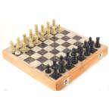
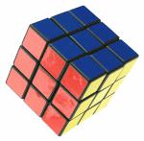
Problem Solving by Searching
Why search ?
Early works of AI was mainly towards
proving theorems
solving puzzles
playing games
All AI is search!
Not totally true (obviously) but more true than you might think.
All life is problem solving !!
Finding a good/best solution to a problem amongst many possible solutions.
‹#›

Slide 3
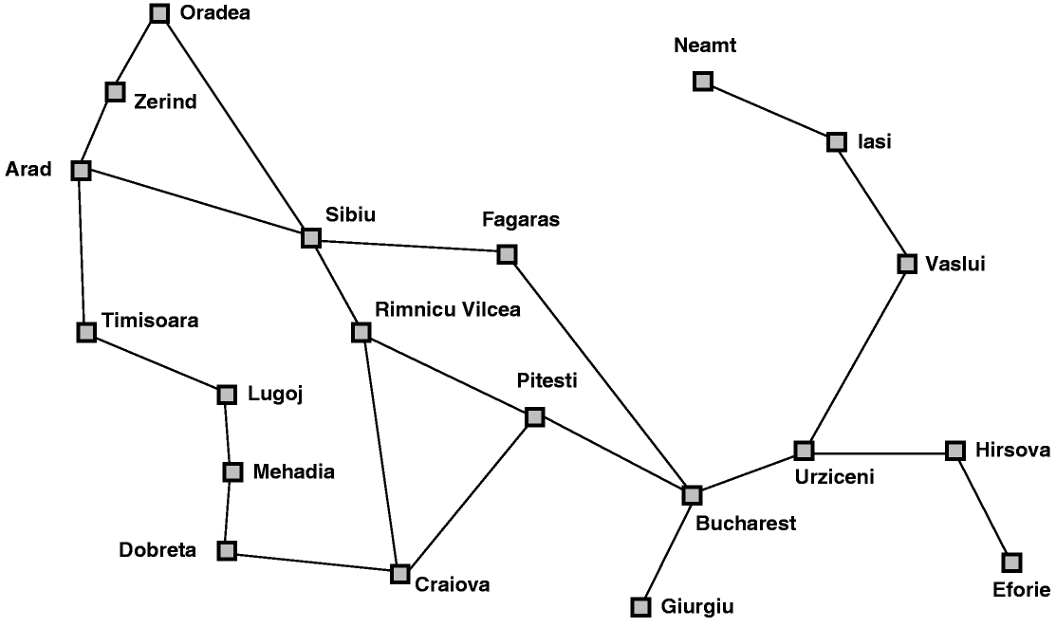
Classic AI Search Problems
Classic AI search problems
Map searching (navigation)
‹#›

Slide 4
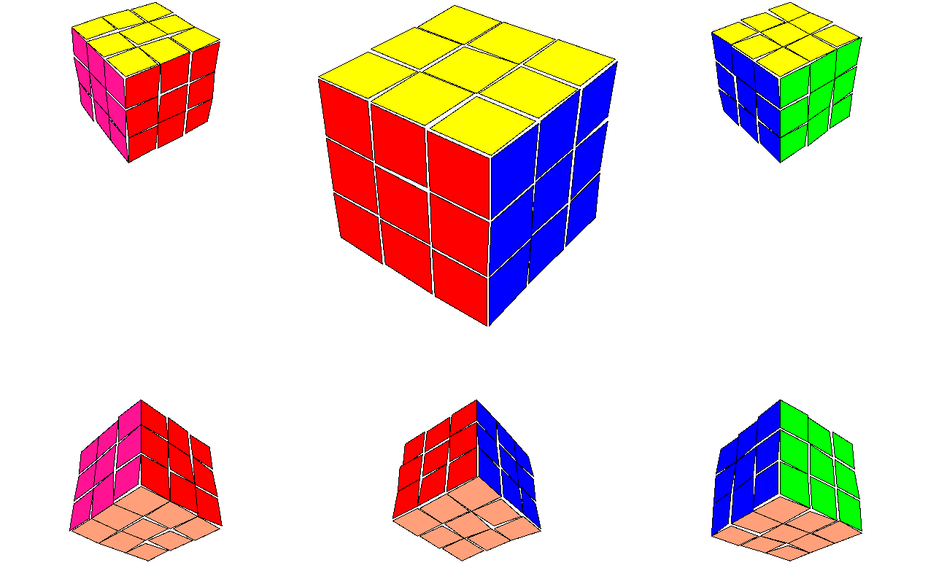
Classic AI Search Problems
3*3*3 Rubik’s Cube
‹#›

Slide 5
Classic AI Search Problems
Classic AI search problems
8-Puzzle
2
1
3
1
2
3
4
7
6
4
5
6
5
8
7
8
‹#›

Slide 6
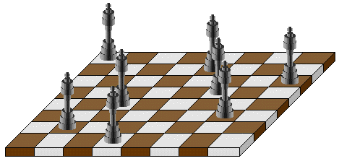
Classic AI Search Problems
Classic AI search problems
N-Queens:
‹#›

Slide 7
Classic AI Search Problems
5-Queens:
1
2
3
4
5
1
2
3
4
5
‹#›

Slide 8
Classic AI Search Problems
5-Queens:
1
2
3
4
5
1
2
3
4
5
‹#›

Slide 9
Classic AI Search Problems
5-Queens:
1
2
3
4
5
1
2
3
4
5
‹#›

Slide 10
Classic AI Search Problems
5-Queens:
1
2
3
4
5
1
2
3
4
5
‹#›

Slide 11
Classic AI Search Problems
5-Queens:
1
2
3
4
5
1
2
3
4
5
‹#›

Slide 12
Classic AI Search Problems
5-Queens:
1
2
3
4
5
1
2
Solution !!
No Queen is under Attack
3
4
5
‹#›

Slide 13
Missionaries and cannibals
Three missionaries and three cannibals are on the left bank of a river.
There is one canoe which can hold one or two people.
Find a way to get everyone to the right bank, without ever leaving a group of missionaries in one place outnumbered by cannibals in that place.
‹#›

Slide 14

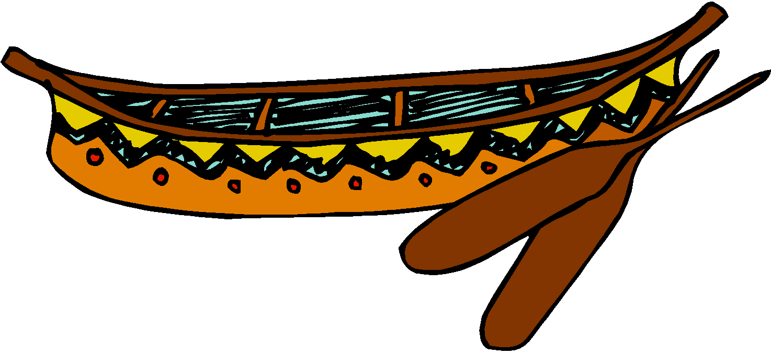
Missionaries and Cannibals
Initial State
‹#›

Slide 15
Missionaries and Cannibals
Goal State
‹#›

Slide 16
The River Problem
A farmer wishes to carry a wolf, a duck and corn across a river, from the south to the north shore. The farmer is the proud owner of a small rowing boat called Bounty which he feels is easily up to the job. Unfortunately the boat is only large enough to carry at most the farmer and one other item. Worse again, if left unattended the wolf will eat the duck and the duck will eat the corn.
How can the farmer safely transport the wolf, the duck and the corn to the opposite shore?
Farmer, Wolf,
Duck and Corn
River
River
boat
boat
Farmer, Wolf,
Duck and Corn
‹#›

Slide 17
Problem Solving by Searching
Problem Formulation

Slide 18
Problem Formulation
A Problem Space consists of
The current state of the world (initial state)
A description of the actions we can take to transform one state of the world into another (operators).
A description of the desired state of the world (goal state), this could be implicit or explicit.
A solution consists of the goal state, or a path to the goal state.
‹#›

Slide 19
Problem Formulation 8-Puzzle Problem
Initial State
Operators
Goal State
2
1
3
1
2
3
Slide blank square left.
Slide blank square right.
….
4
7
6
4
5
6
5
8
7
8
‹#›

Slide 20
Problem Formulation 8-Puzzle Problem
Representing states:
For the 8-puzzle
3 by 3 array
5, 6, 7
8, 4, BLANK
3, 1, 2
A vector of length nine
5,6,7,8,4, BLANK,3,1,2
A list of facts
Upper_left = 5
Upper_middle = 6
Upper_right = 7
Middle_left = 8
5
6
7
8
4
3
1
2
‹#›

Slide 21
Problem Formulation 8-Puzzle Problem
Specifying operators:
There are often many ways to specify the operators, some will be much easier to implement...
Move 1 left
Move 1 right
Move 1 up
Move 1 down
Move 2 left
Move 2 right
Move 2 up
Move 2 down
Move 3 left
Move 3 right
Move 3 up
Move 3 down
Move 4 left
…
Move Blank left
Move Blank right
Move Blank up
Move Blank down
5
6
7
8
4
3
1
2
‹#›

Slide 22
Problem Formulation 8-Puzzle Problem
1
2
3
1
2
3
4
8
4
5
6
7
6
5
7
8
Initial state
Goal state
Operators: slide blank up, slide blank down, slide blank left, slide blank right
1
2
3
1
2
3
1
2
3
1
2
3
1
2
3
1
2
3
4
8
4
8
5
4
8
5
4
5
4
5
4
5
6
7
6
5
7
6
7
6
7
8
6
7
8
6
7
8
Solution: sb-down, sb-left, sb-up,sb-right, sb-down
Path cost: 5 steps to reach the goal
‹#›

Slide 23
Problem Solving by Searching
A toy problem:
Missionaries and Cannibals

Slide 24
Missionaries and cannibals
Three missionaries and three cannibals are on the left bank of a river.
There is one canoe which can hold one or two people.
Find a way to get everyone to the right bank, without ever leaving a group of missionaries in one place outnumbered by cannibals in that place.
‹#›

Slide 25
Missionaries and cannibals
States: three numbers (i,j,k) representing the number of missionaries, cannibals, and canoes on the left bank of the river.
Initial state: (3, 3, 1)
Operators: take one missionary, one cannibal, two missionaries, two cannibals, one missionary and one cannibal across the river in a given direction (I.e. ten operators).
Goal Test: reached state (0, 0, 0)
Path Cost: Number of crossings.
‹#›

Slide 26
Missionaries and Cannibals
(3,3,1): Initial State
‹#›

Slide 27
Missionaries and Cannibals
A missionary and cannibal cross
‹#›

Slide 28
Missionaries and Cannibals
(2,2,0)
‹#›

Slide 29
Missionaries and Cannibals
One missionary returns
‹#›

Slide 30
Missionaries and Cannibals
(3,2,1)
‹#›

Slide 31
Missionaries and Cannibals
Two cannibals cross
‹#›

Slide 32
Missionaries and Cannibals
(3,0,0)
‹#›

Slide 33
Missionaries and Cannibals
A cannibal returns
‹#›

Slide 34
Missionaries and Cannibals
(3,1,1)
‹#›

Slide 35
Missionaries and Cannibals
Two missionaries cross
‹#›

Slide 36
Missionaries and Cannibals
(1,1,0)
‹#›

Slide 37
Missionaries and Cannibals
A missionary and cannibal return
‹#›

Slide 38
Missionaries and Cannibals
(2,2,1)
‹#›

Slide 39
Missionaries and Cannibals
Two Missionaries cross
‹#›

Slide 40
Missionaries and Cannibals
(0,2,0)
‹#›

Slide 41
Missionaries and Cannibals
A cannibal returns
‹#›

Slide 42
Missionaries and Cannibals
(0,3,1)
‹#›

Slide 43
Missionaries and Cannibals
Two cannibals cross
‹#›

Slide 44
Missionaries and Cannibals
(0,1,0)
‹#›

Slide 45
Missionaries and Cannibals
A cannibal returns
‹#›

Slide 46
Missionaries and Cannibals
(0,2,1)
‹#›

Slide 47
Missionaries and Cannibals
The last two cannibals cross
‹#›

Slide 48
Missionaries and Cannibals
(0,0,0) : Goal State
‹#›

Slide 49
Missionaries and Cannibals
Solution = the sequence of actions within the path : [ (3,3,1)→ (2,2,0)→(3,2,1) →(3,0,0) →(3,1,1) →(1,1,0) →(2,2,1) →(0,2,0) →(0,3,1) →(0,1,0) → (0,2,1) →(0,0,0)]; Cost = 11 crossings
‹#›

Slide 50
Problem Solving by Searching
The River Problem:
Farmer, Wolf, Duck and Corn

Slide 51
The River Problem
Let’s consider the River Problem:
A farmer wishes to carry a wolf, a duck and corn across a river, from the south to the north shore. The farmer is the proud owner of a small rowing boat called Bounty which he feels is easily up to the job. Unfortunately the boat is only large enough to carry at most the farmer and one other item. Worse again, if left unattended the wolf will eat the duck and the duck will eat the corn.
How can the farmer safely transport the wolf, the duck and the corn to the opposite shore?
River
boat
Farmer, Wolf,
Duck and Corn
‹#›

Slide 52
The River Problem
The River Problem:
F=Farmer W=Wolf D=Duck C=Corn /=River
How can the farmer safely transport the wolf, the duck and the corn to the opposite shore?
-/FWCD
FWCD/-
‹#›

Slide 53
The River Problem
Problem formulation:
State representation: location of farmer and items in both sides of river
[items in South shore / items in North shore] : (FWDC/-, FD/WC, C/FWD …)
Initial State: farmer, wolf, duck and corn in the south shore FWDC/-
Goal State: farmer, duck and corn in the north shore
-/FWDC
Operators: the farmer takes in the boat at most one item from one side to the other side
(F-Takes-W, F-Takes-D, F-Takes-C, F-Takes-Self [himself only])
Path cost: the number of crossings
‹#›

Slide 54
The River Problem
Problem solution: (path Cost = 7)
While there are other possibilities here is one 7 step solution to the river problem
F
D
D
F
W
D
F-Takes-D
F-Takes-S
F-Takes-W
F
W
D
C
W
C
F
W
C
C
Initial State
WC/FD
FWC/D
C/FWD
F-Takes-D
F
W
D
C
W
C
F
W
C
W
F-Takes-D
F-Takes-S
F-Takes-C
F
D
D
F
D
C
‹#›
Goal State
FD/WC
D/FWC
FDC/W

Slide 55
Summary
Search: process of constructing sequences of actions that achieve a goal given a problem.
It is assumed that the environment is observable, deterministic, static and completely known.
Goal formulation is the first step in solving problems by searching. It facilitates problem formulation.
Formulating a problem requires specifying five components: State representation, Initial state, Goal state, Operators (actions), and Path cost function.
‹#›

